Slide 1
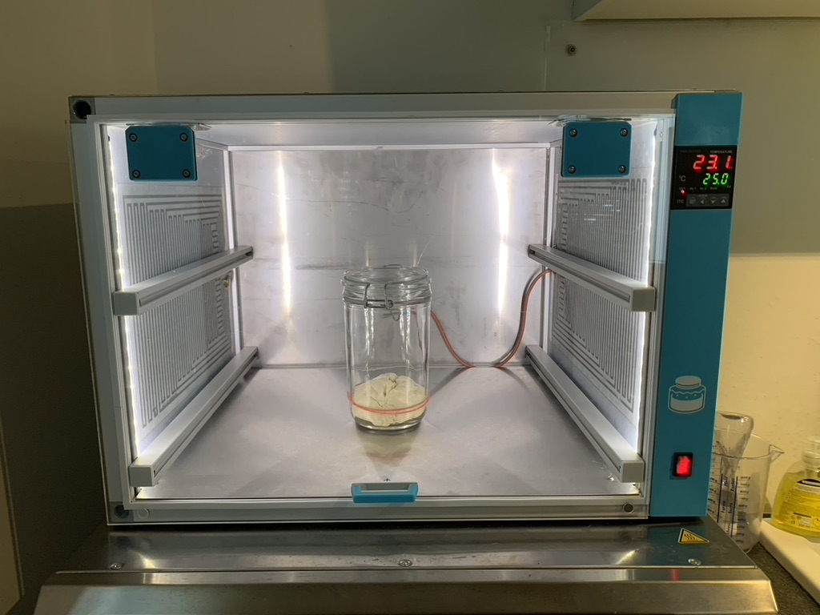

Slide 2
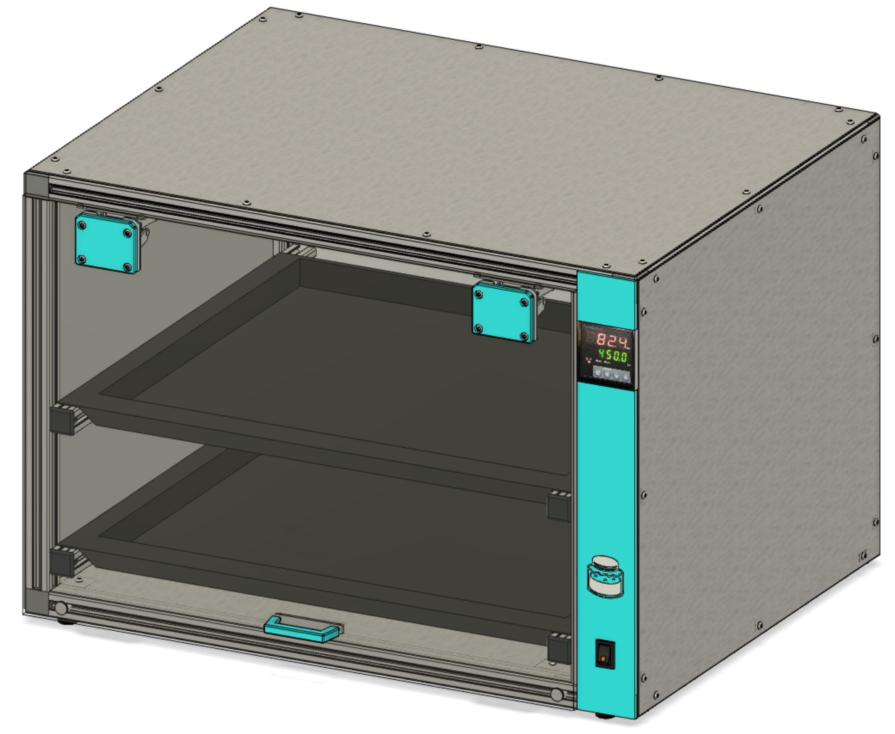

Slide 3
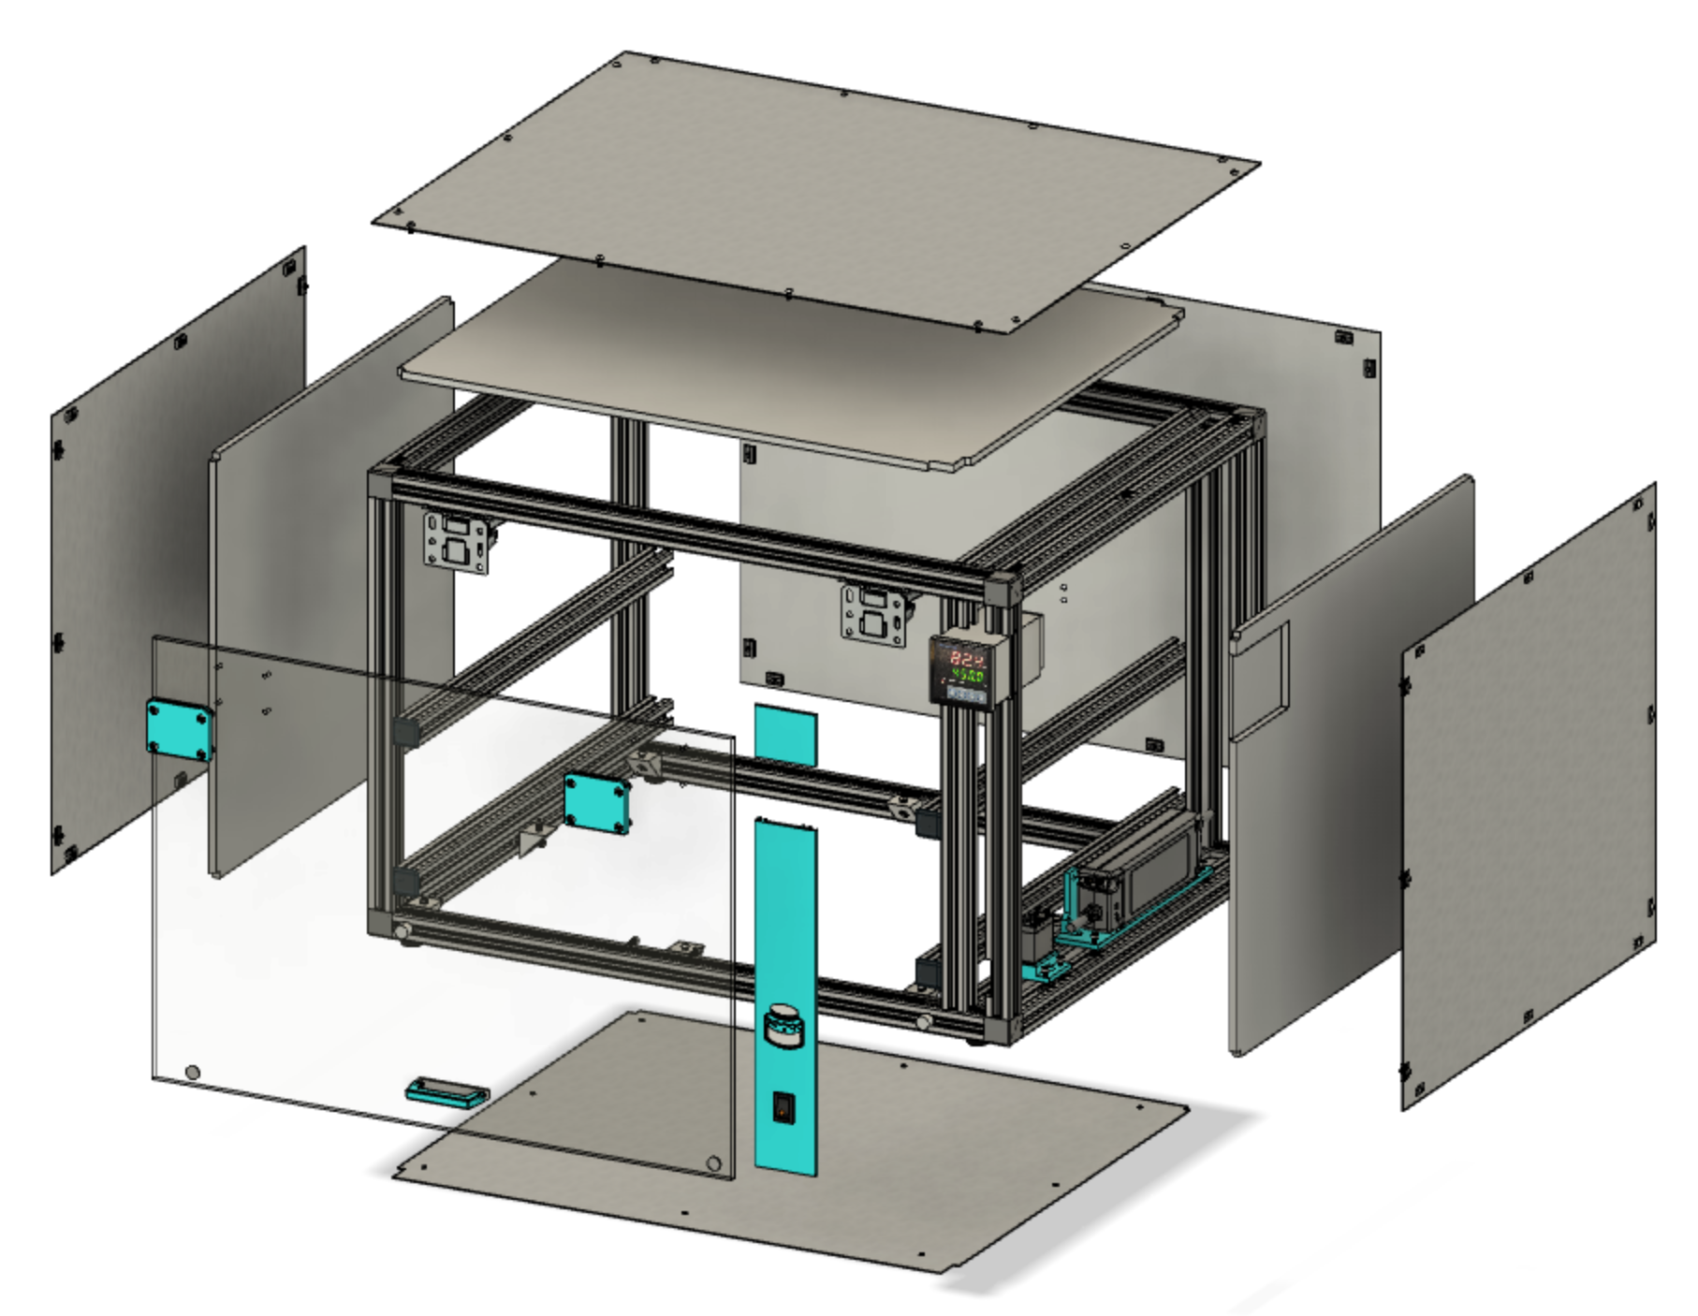
0.8mm stainless steel
6mm honeycomb
polypropylen
5mm acrylic glas

Slide 4
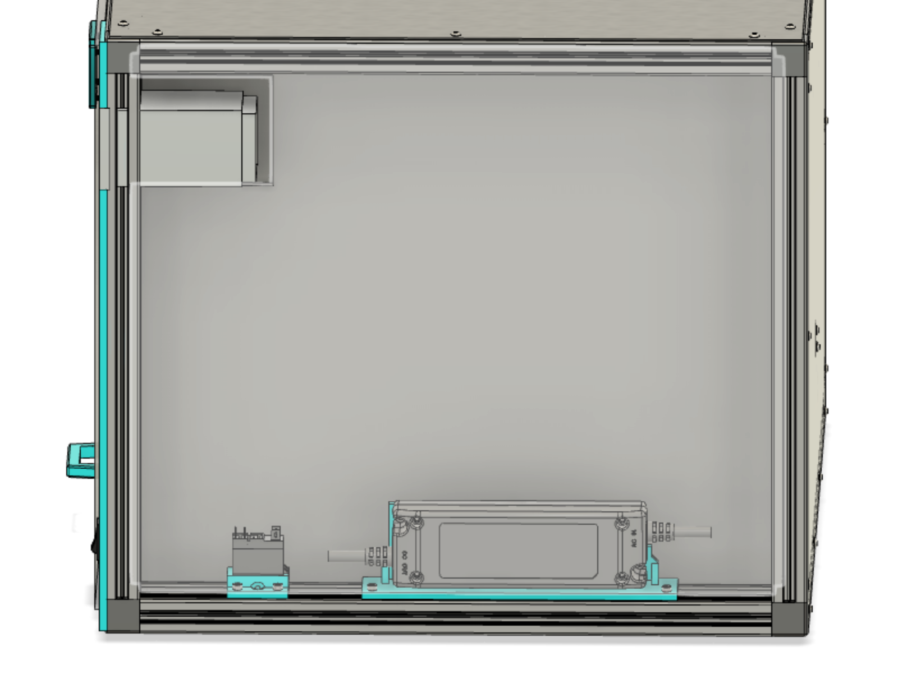
Inkbird
ITC-100VL
Crydom ED06D5
Mean Well
PLN 30-12

Slide 5
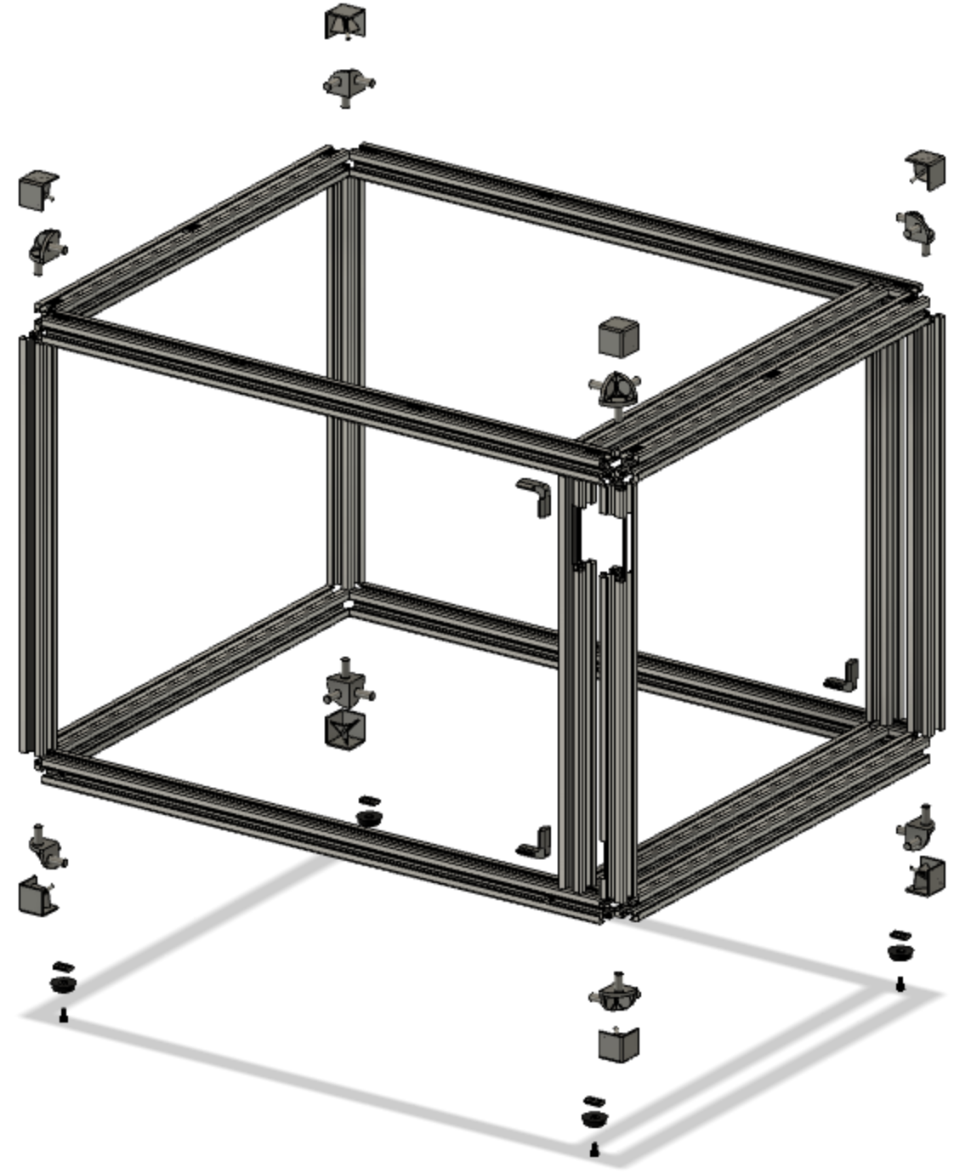
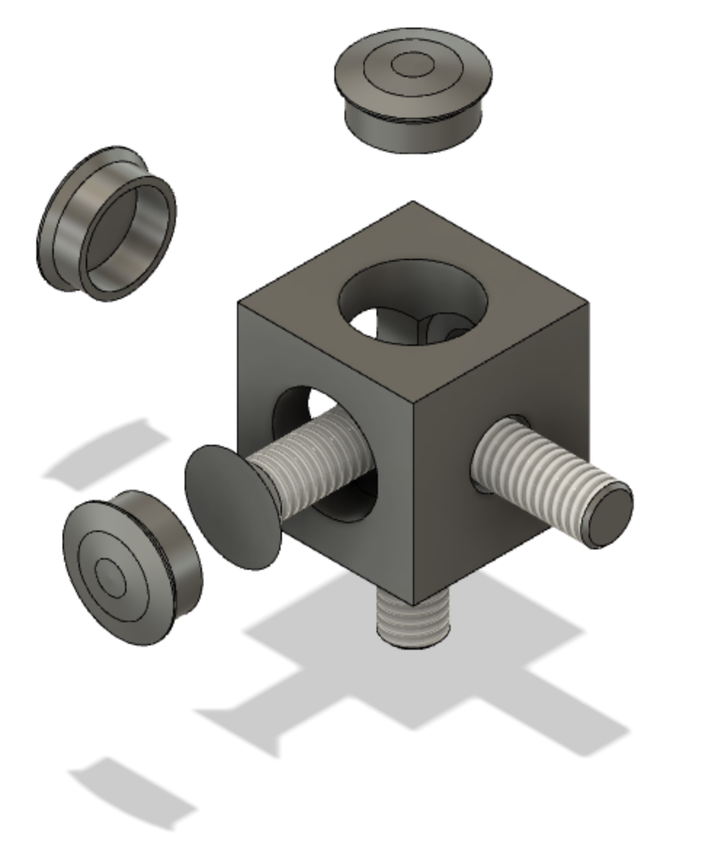
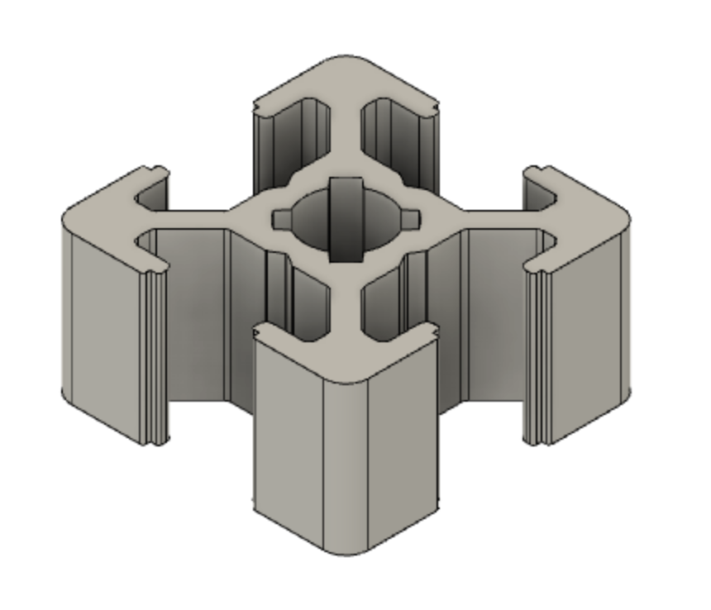
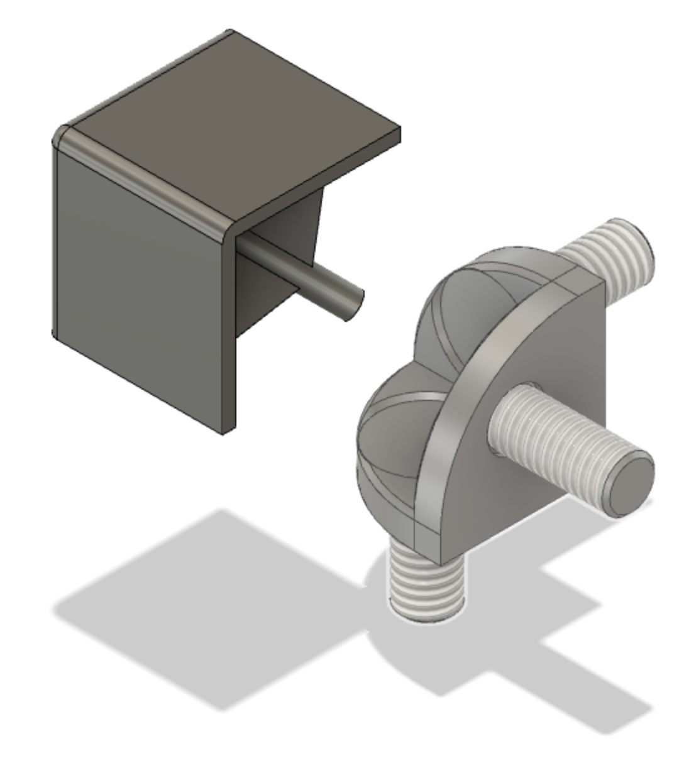
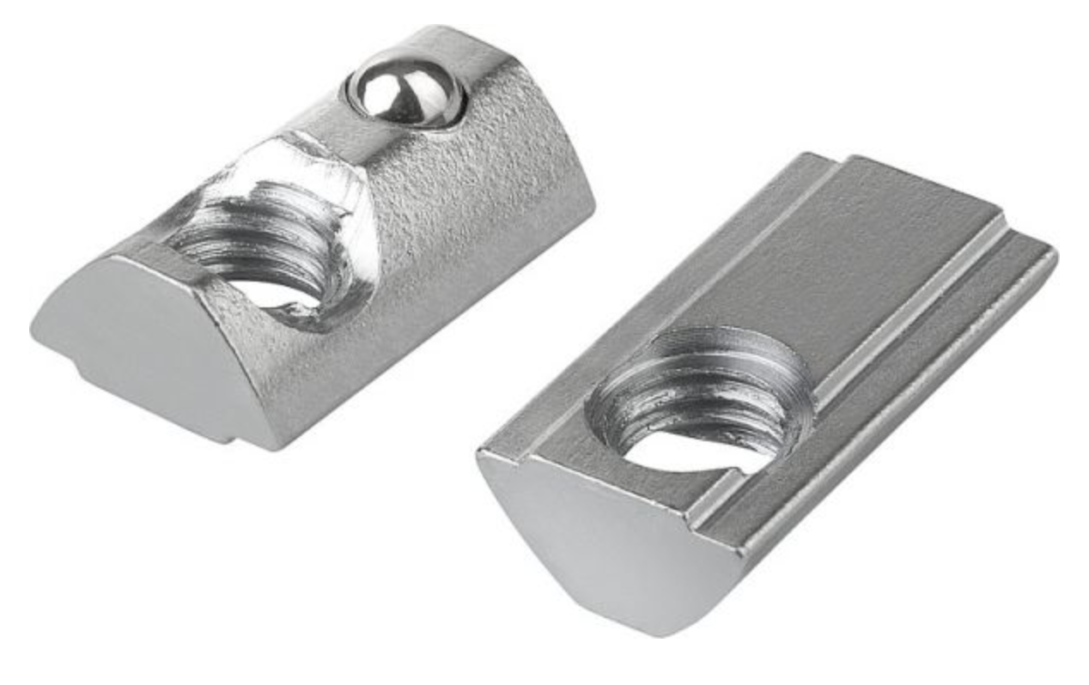
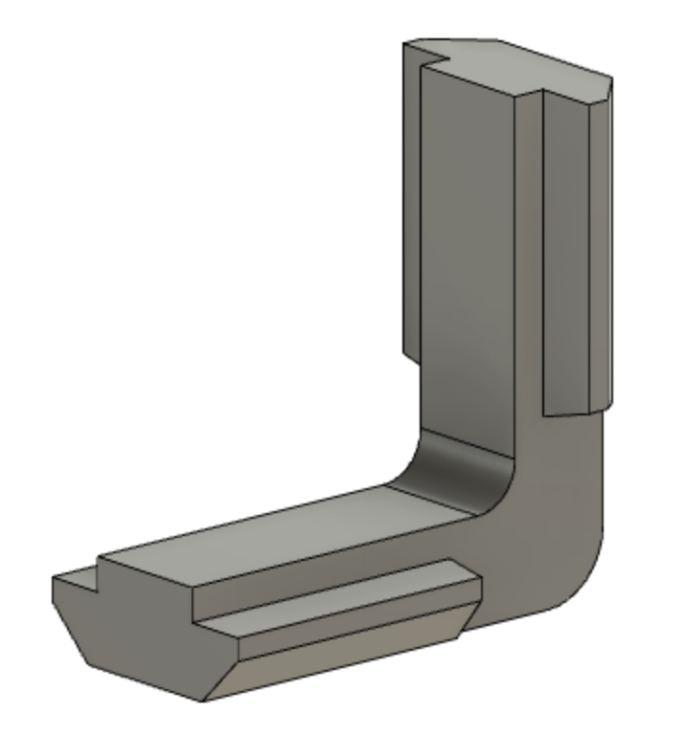
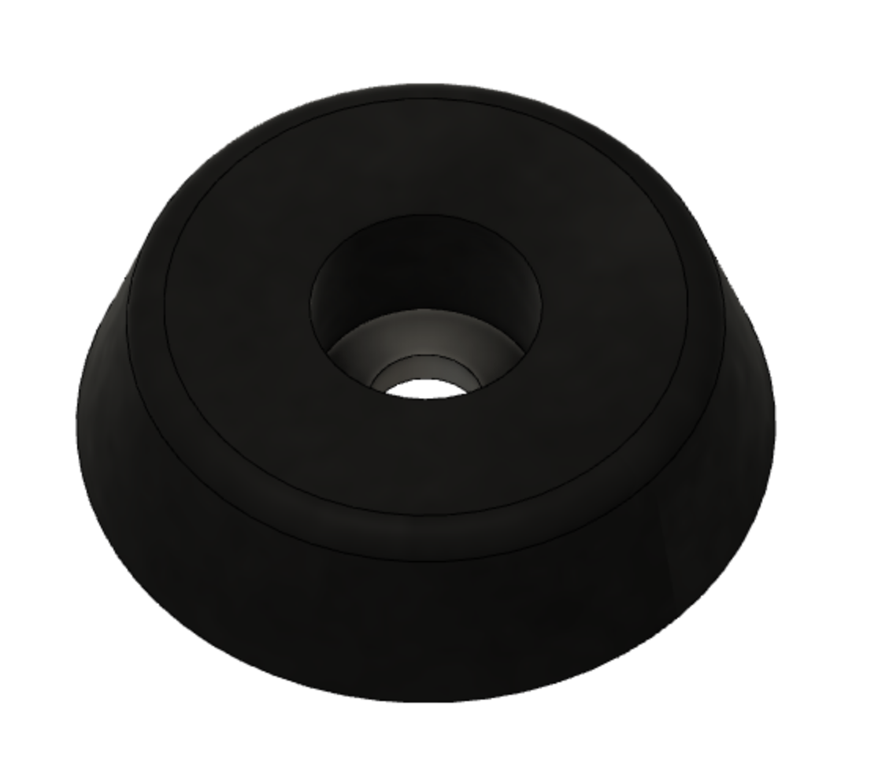
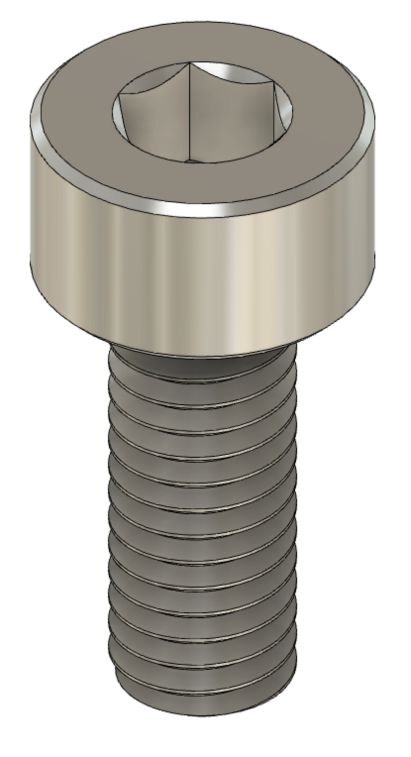
or
Bosch 6 nut
20x20mm
aluminium
profile
6mm M3 DIN-912

Slide 6
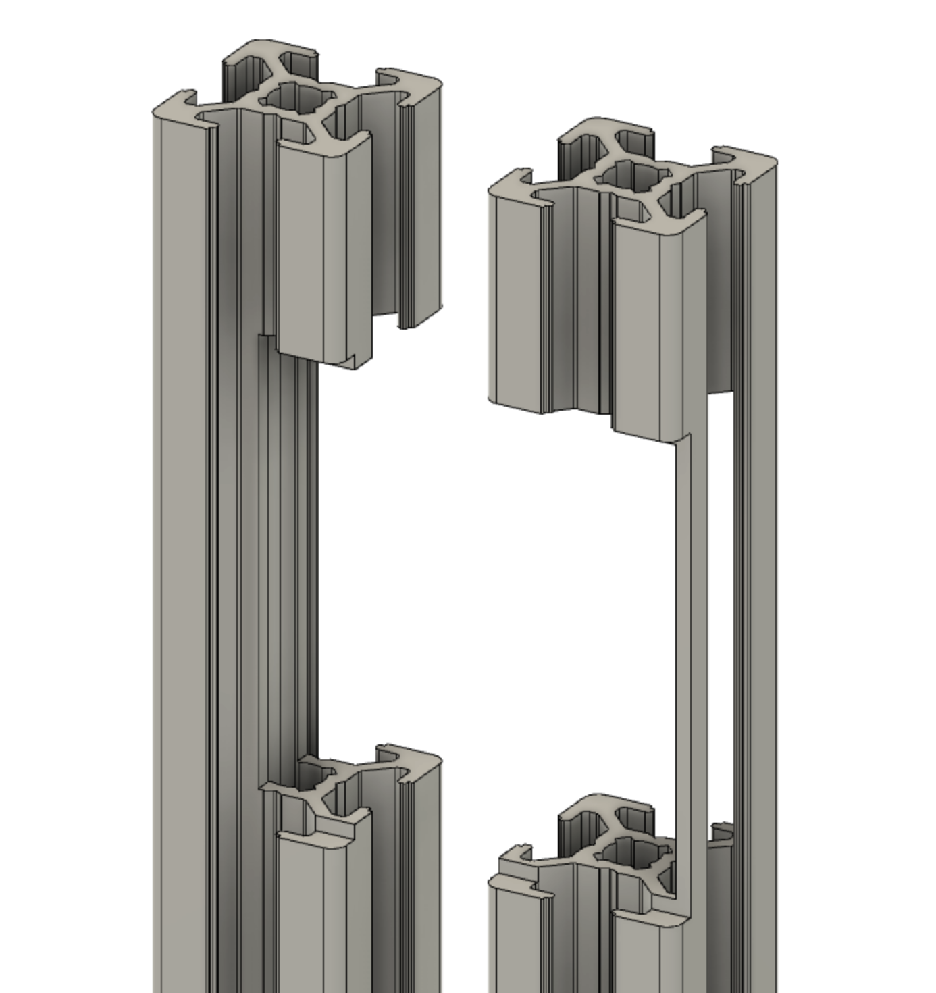
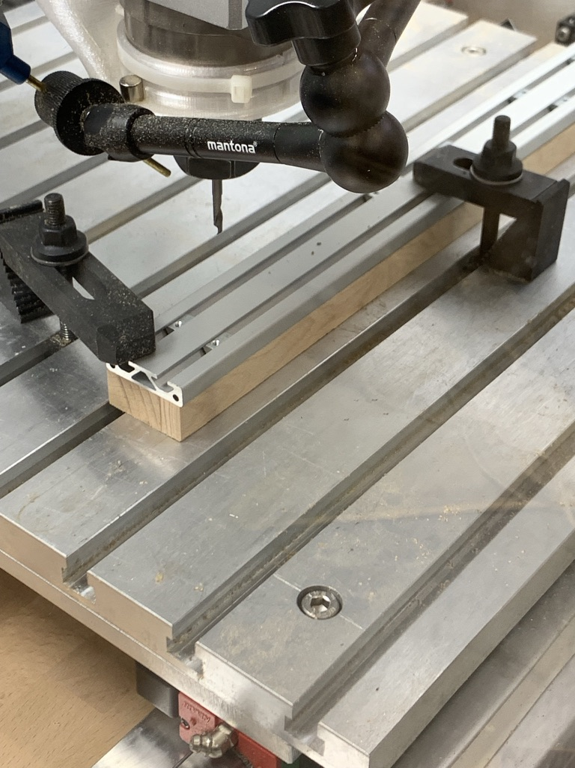
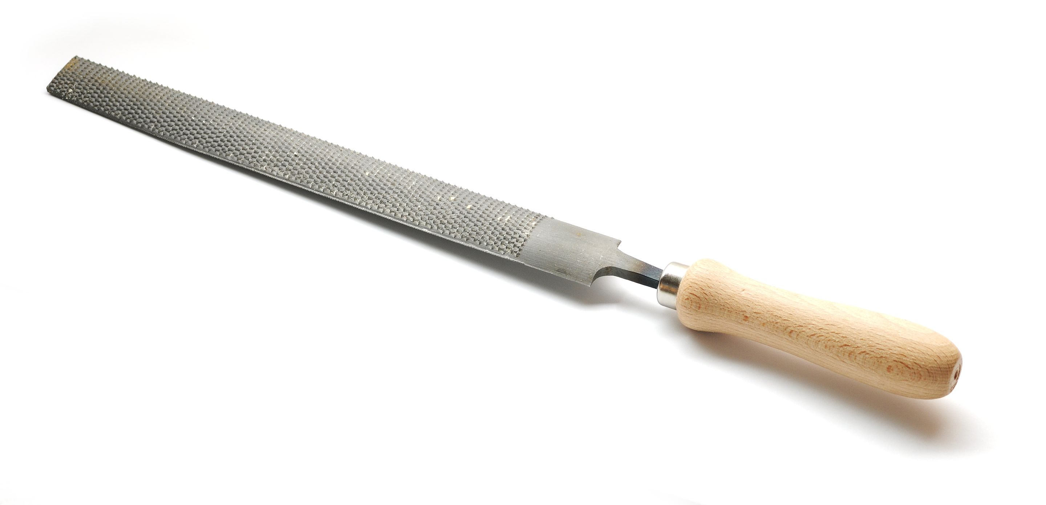
This can be CNC milled
or manually using a file.
Aluminium isn't that hard.

Slide 7
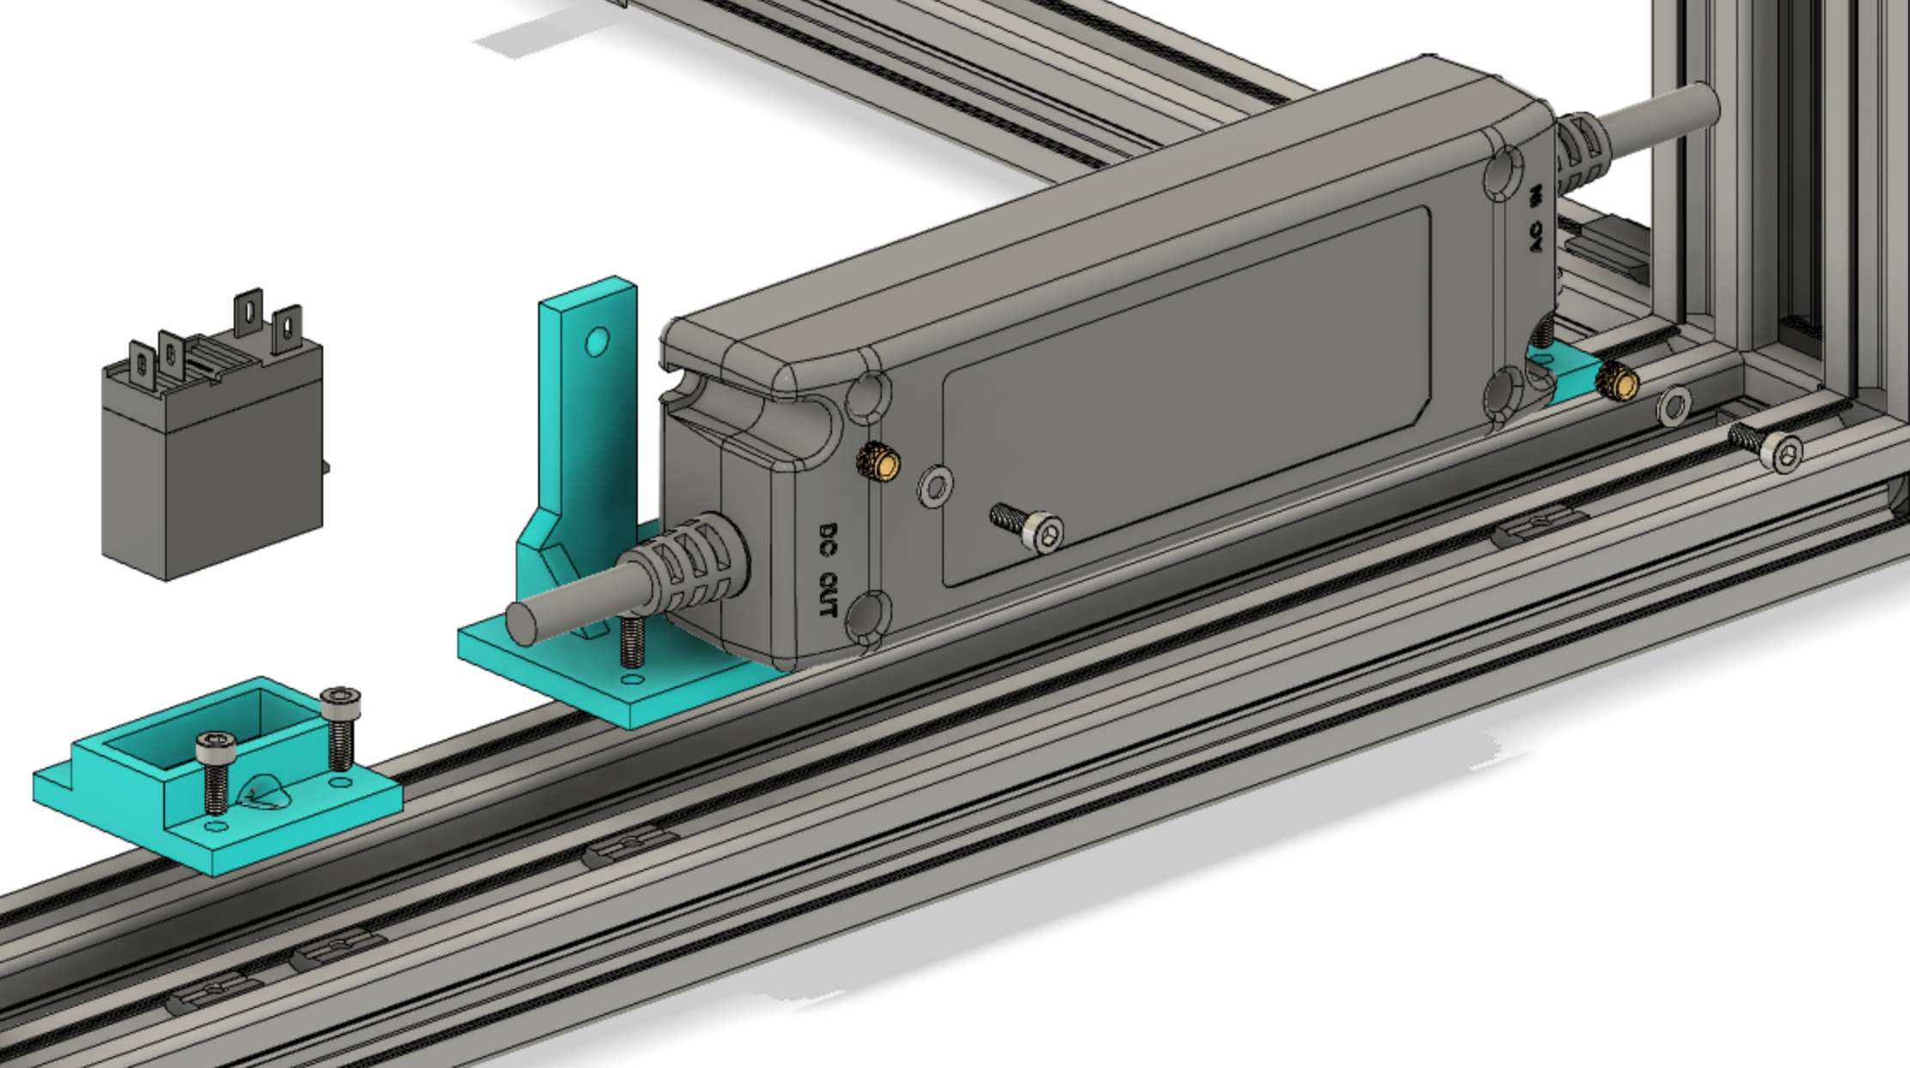
Crydom ED06D5
Mean Well
PLN 30-12
8mm M3 DIN-912
M3 threaded insert
M3 washer
8mm M3 DIN-912

Slide 8
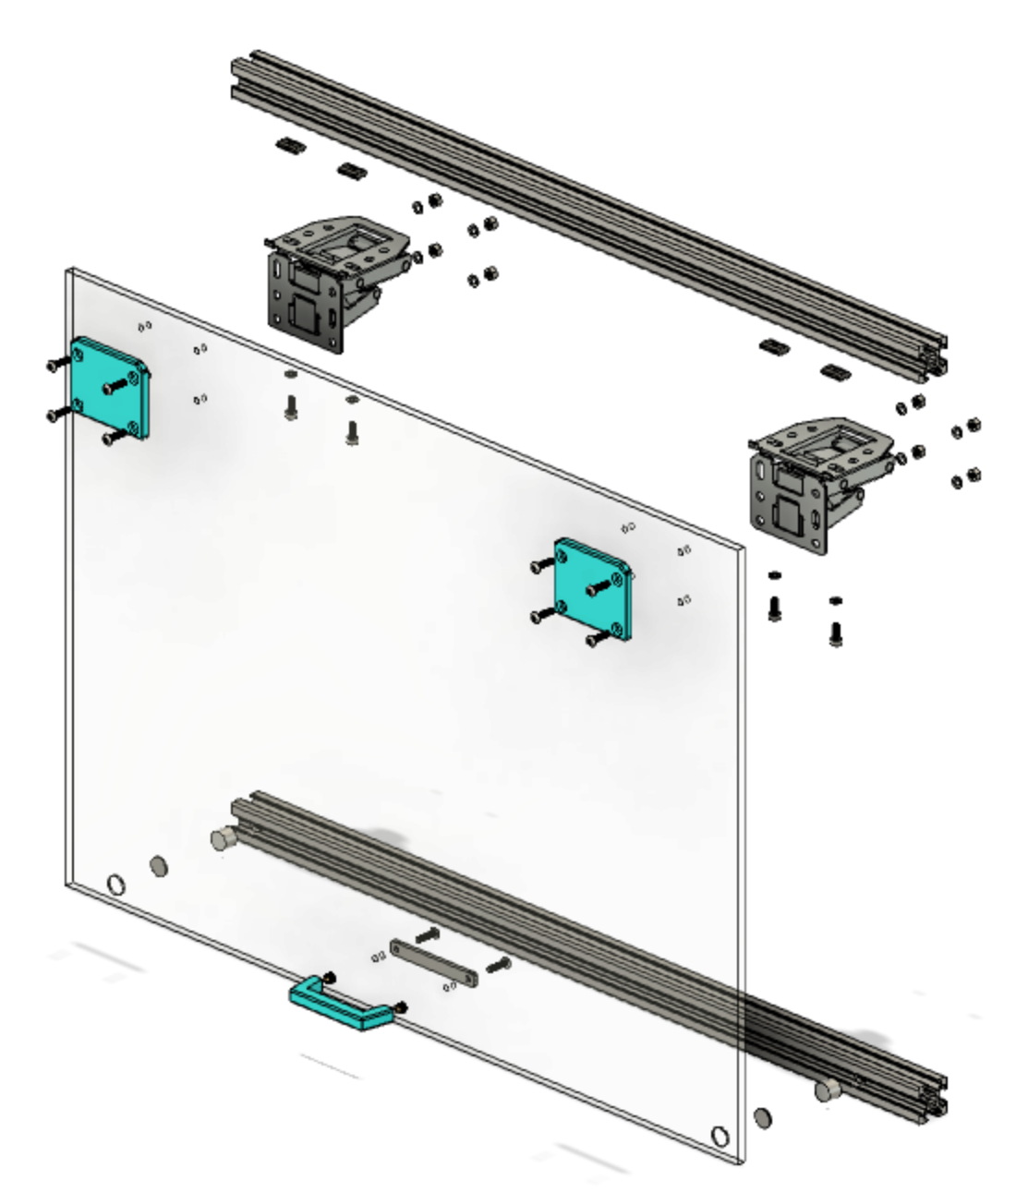
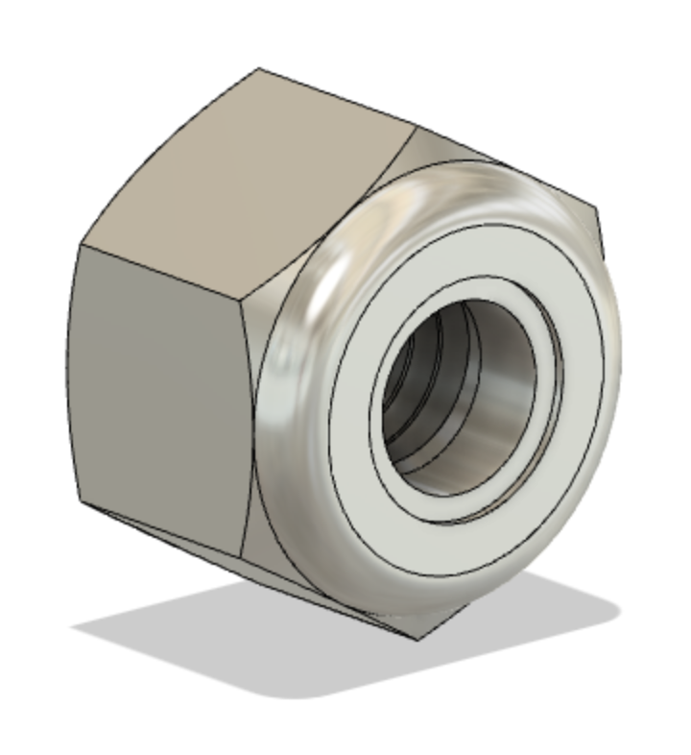
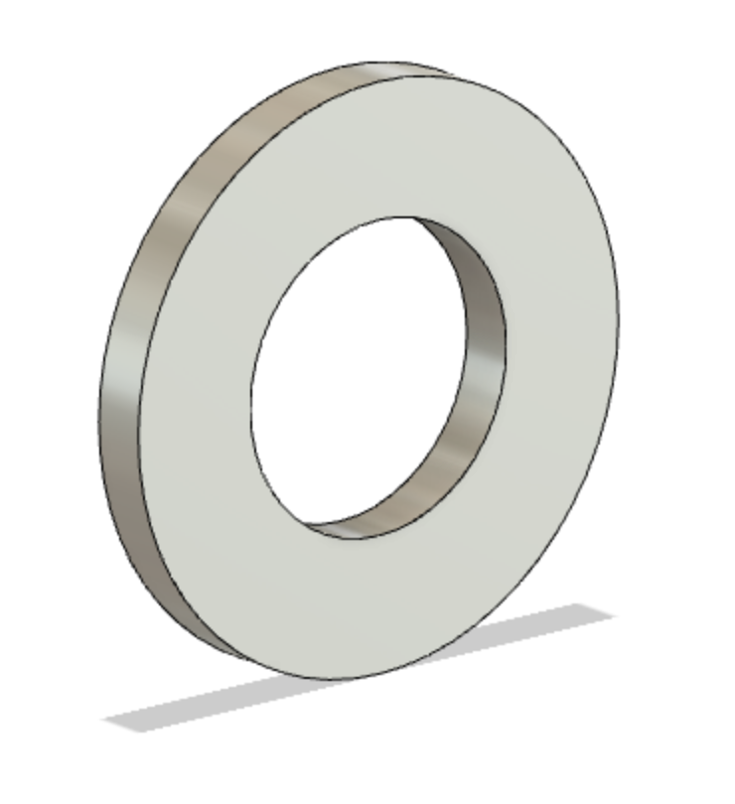
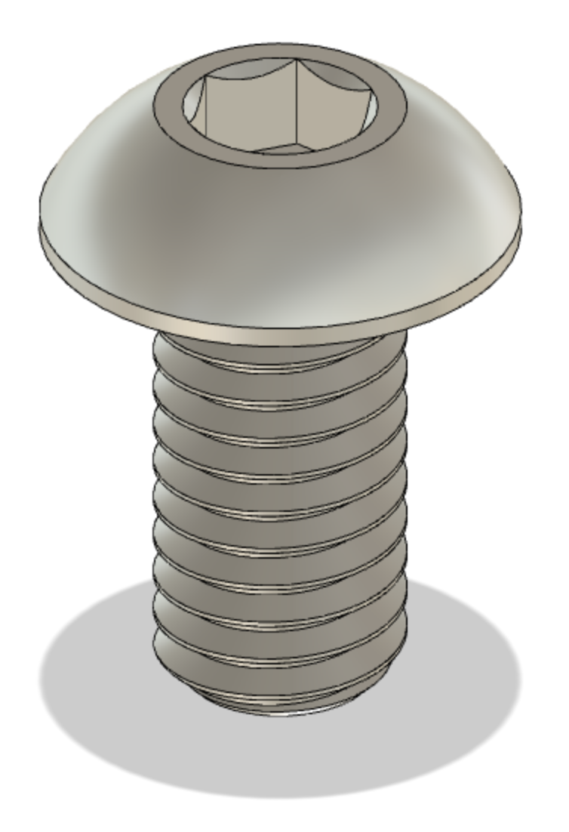
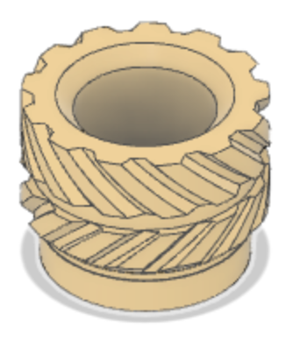
Häfele CH 300 soft-close hinge
M3 lock nut
M3 washer
8mm M3 DIN-912
10x8mm neodym magnet
5mm acrylic
glas (plexi glas)
12mm M3 ISO-7380-1
10x1mm neodym magnet
12mm M3 DIN-912
M3 threaded insert 5x4x3

Slide 9
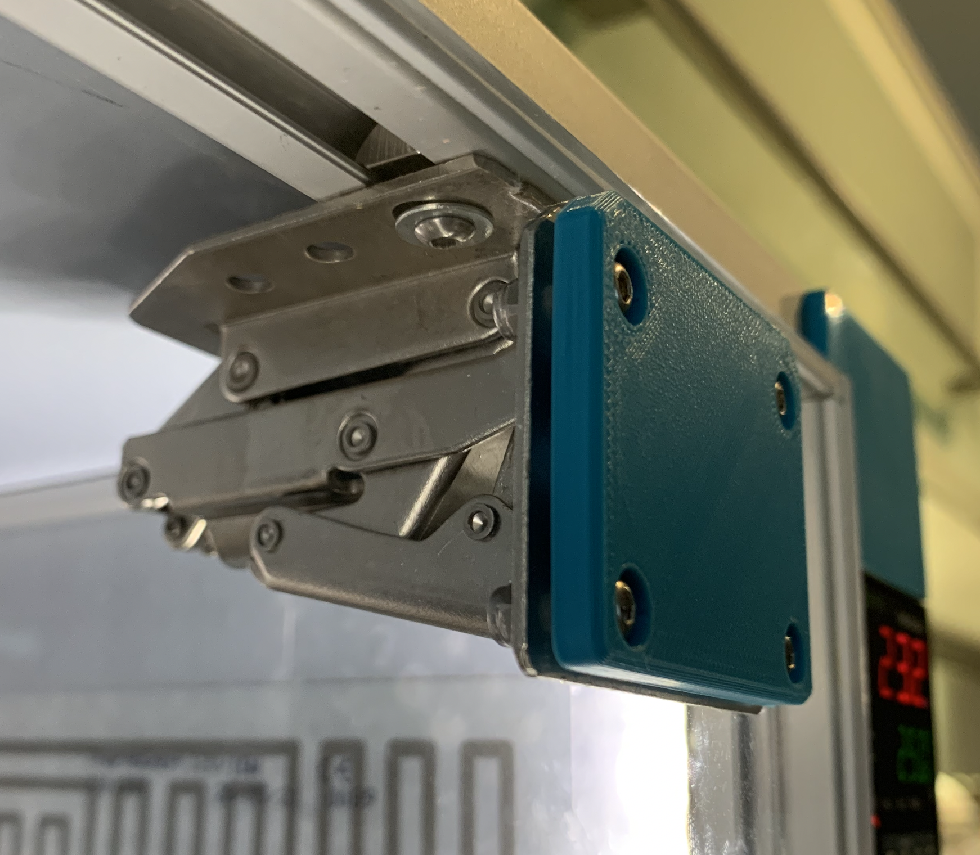

Slide 10
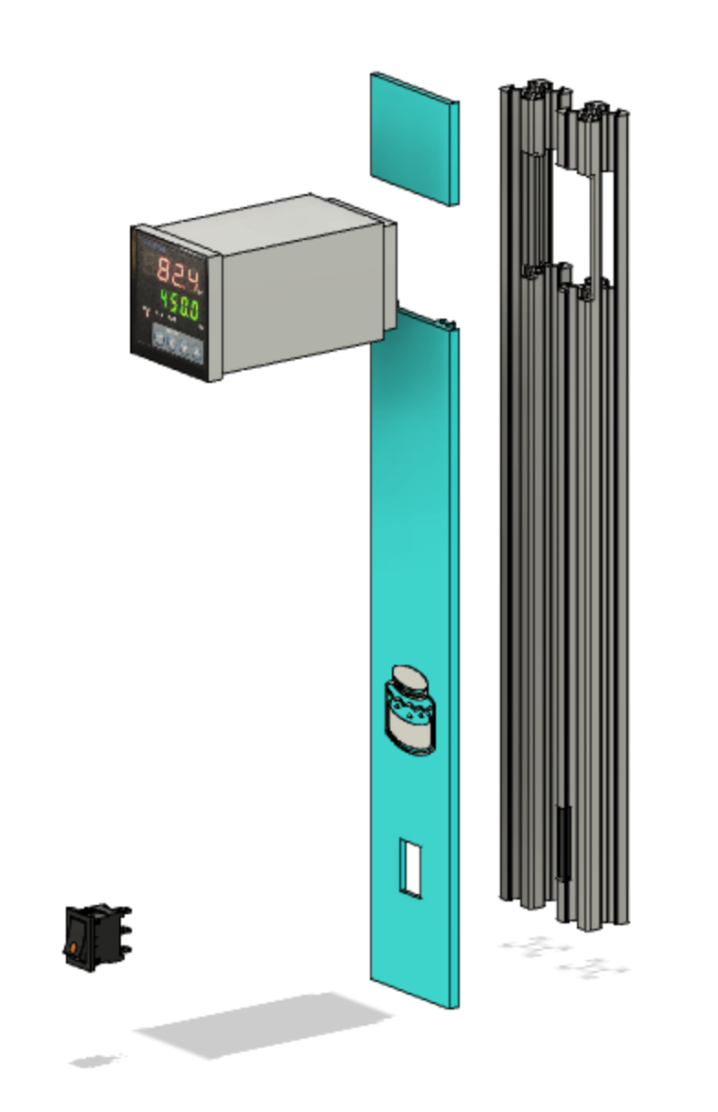
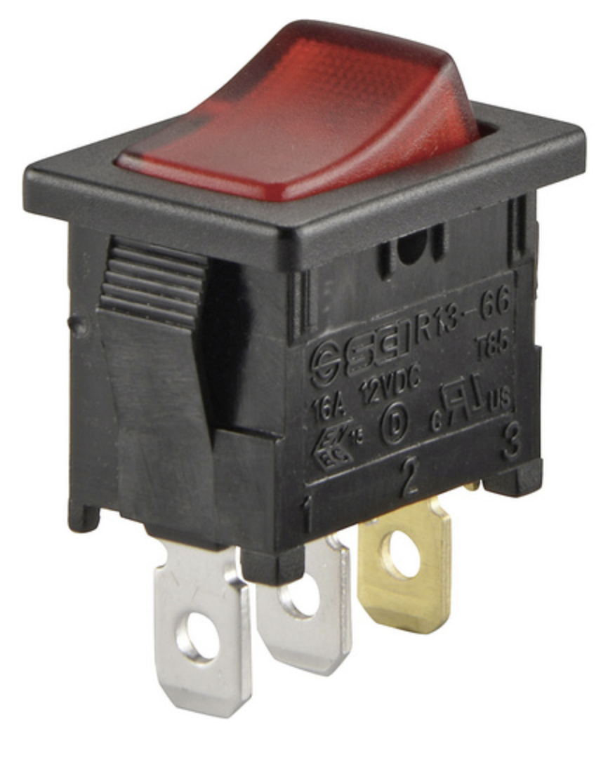
Inkbird ITC-100VL 12V for SSR
TC-R13-66B-02
12V 16A switch with LED light

Slide 11
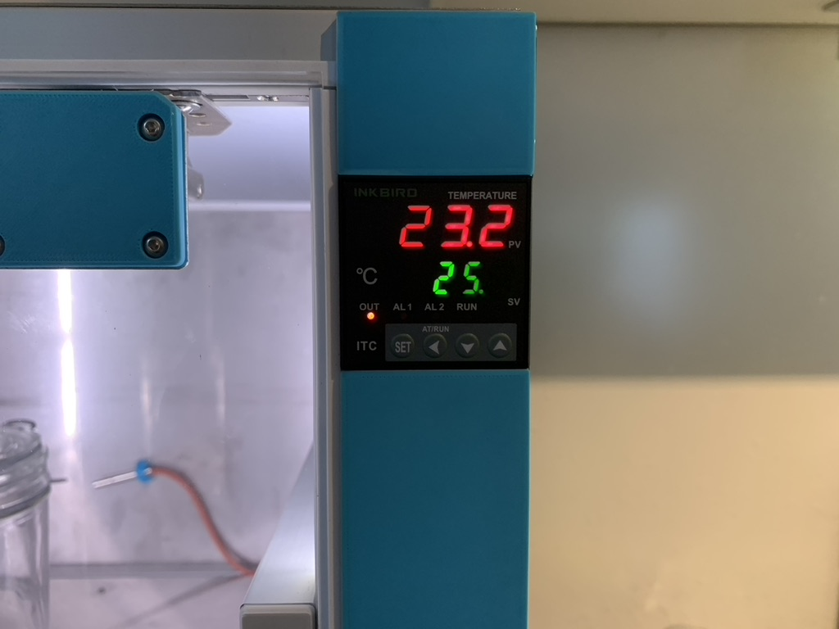

Slide 12
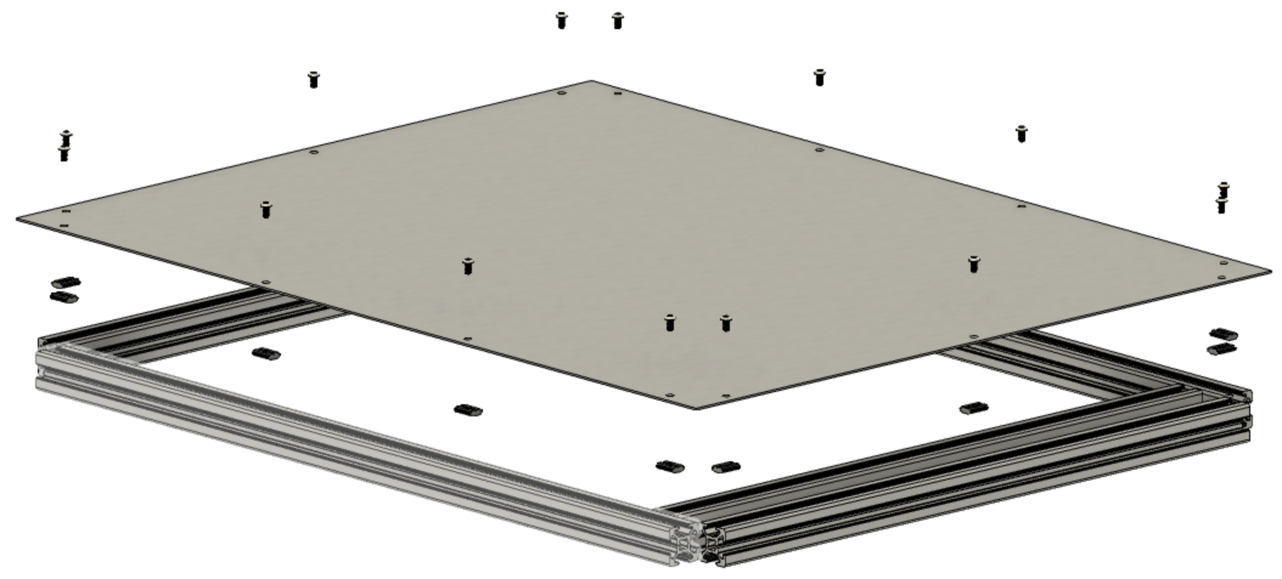
6mm M3 ISO-7380-1

Slide 13
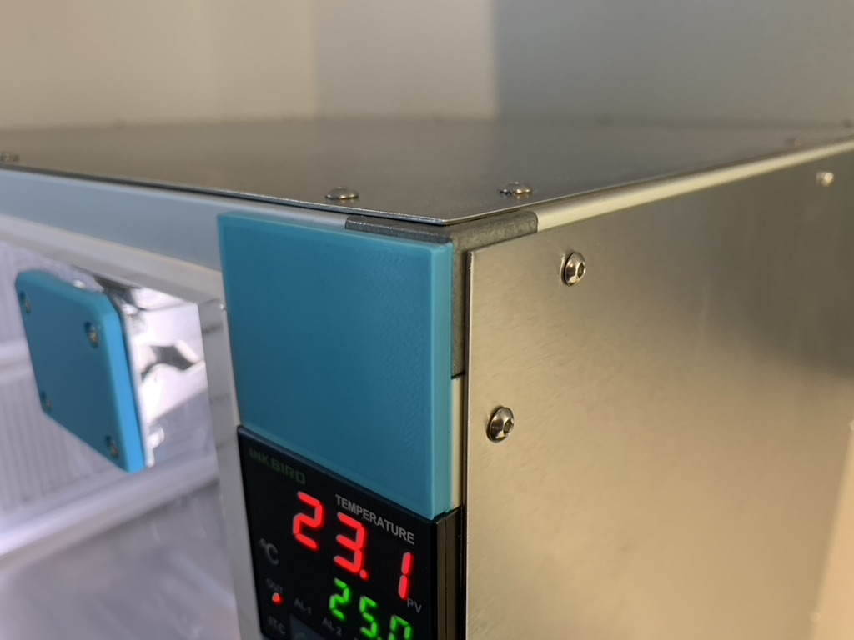

Slide 14
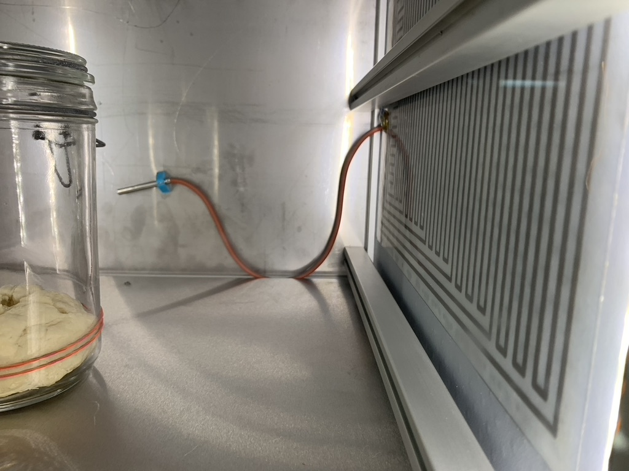
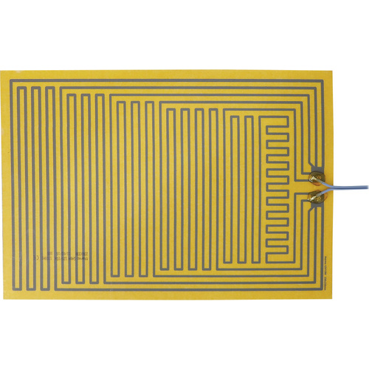
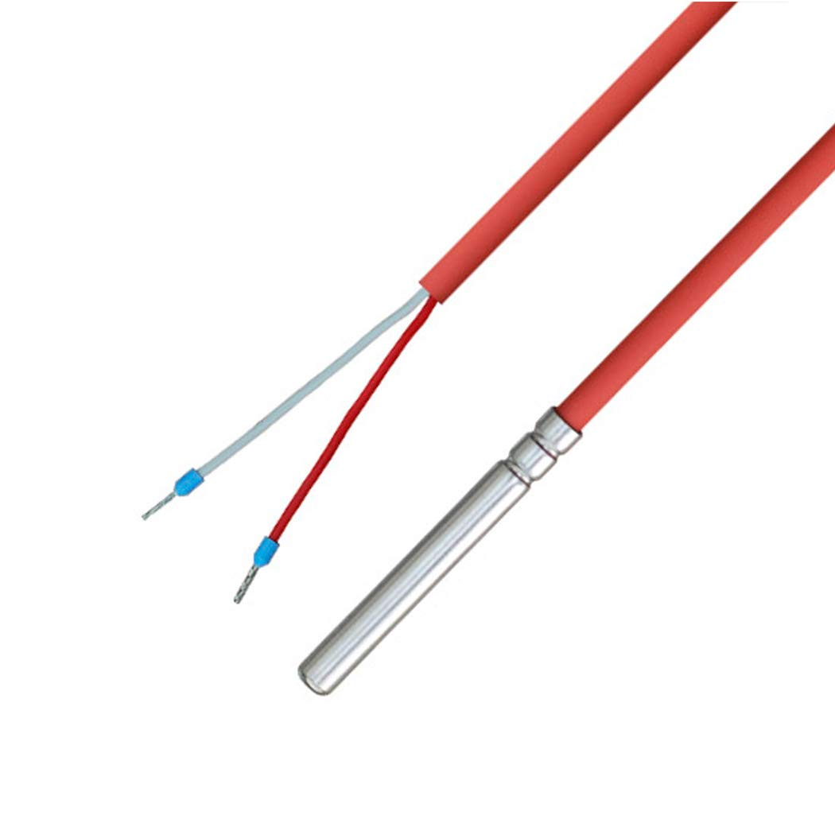
PT100
Thermo TECH Polyester
heating foil
12V 15W
330x230mm
PT100
iOVEO 036HS01201 - PT100
temperature sensor

Slide 15
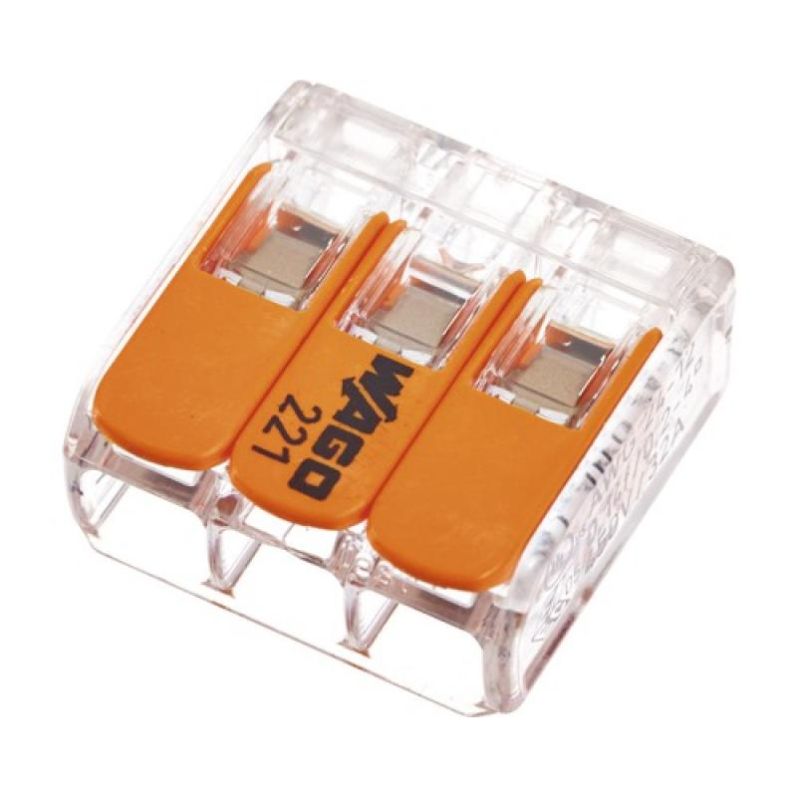
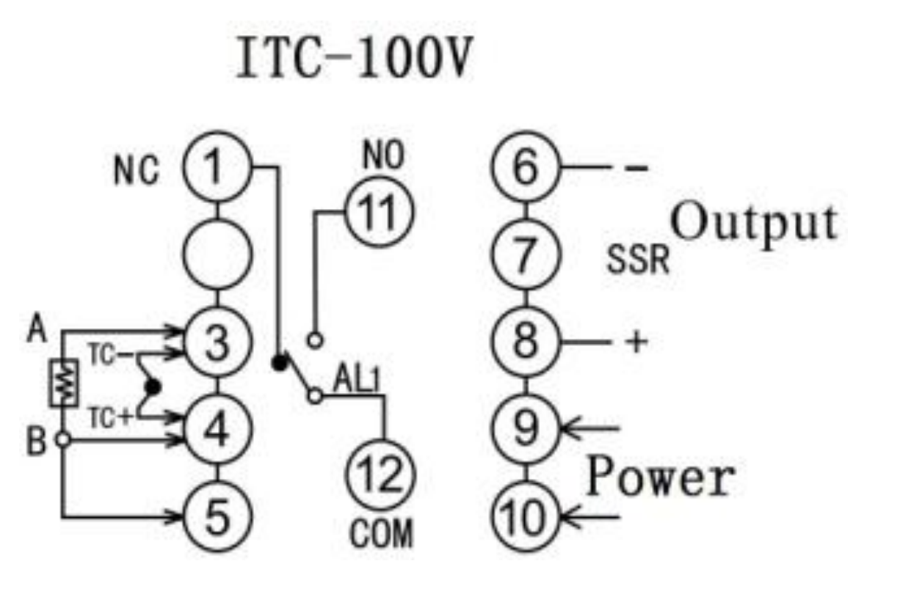
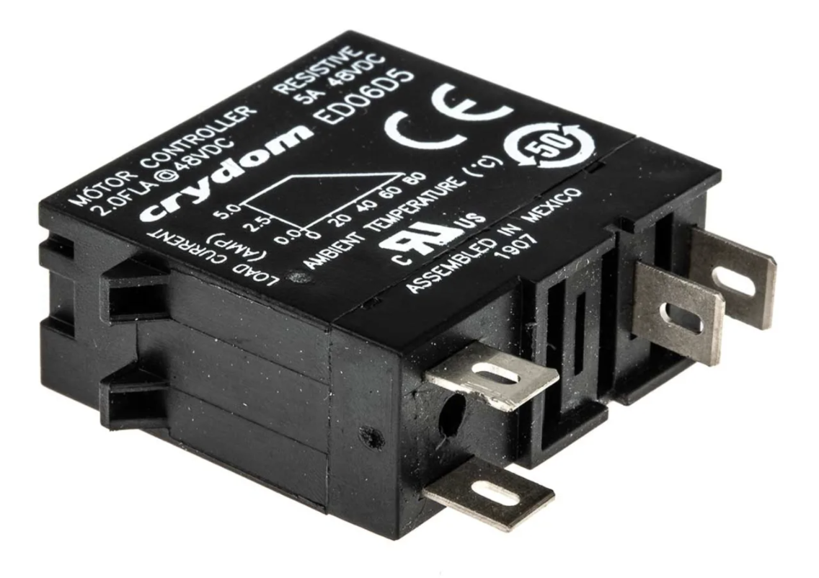
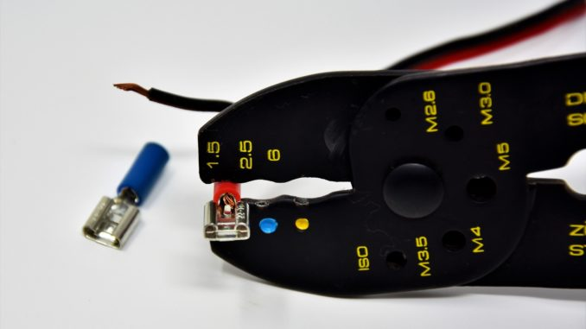
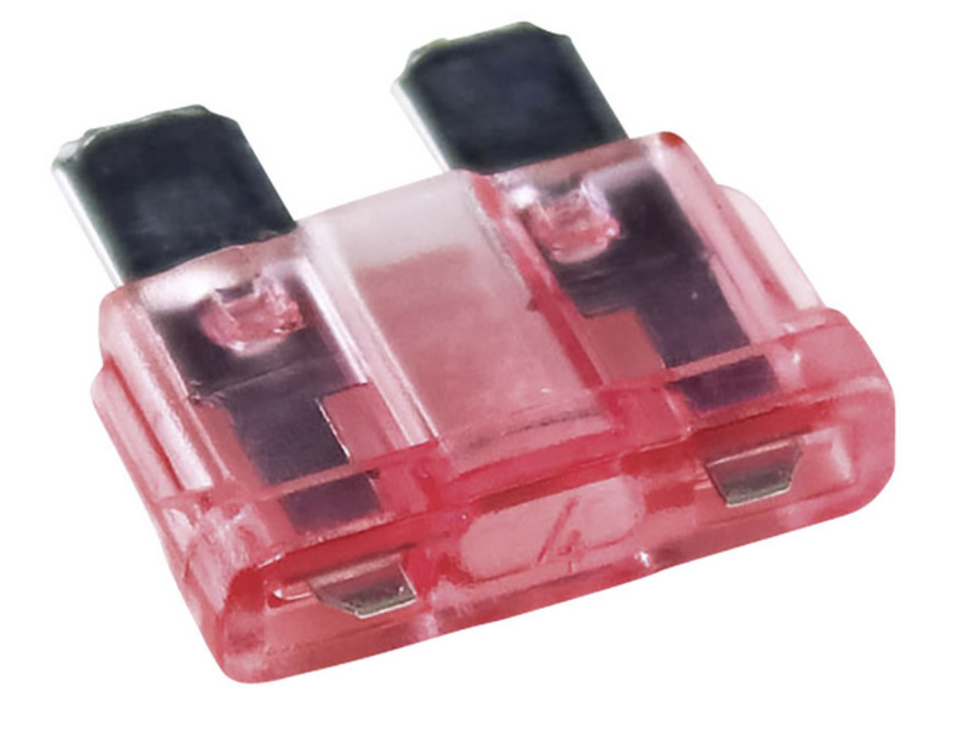
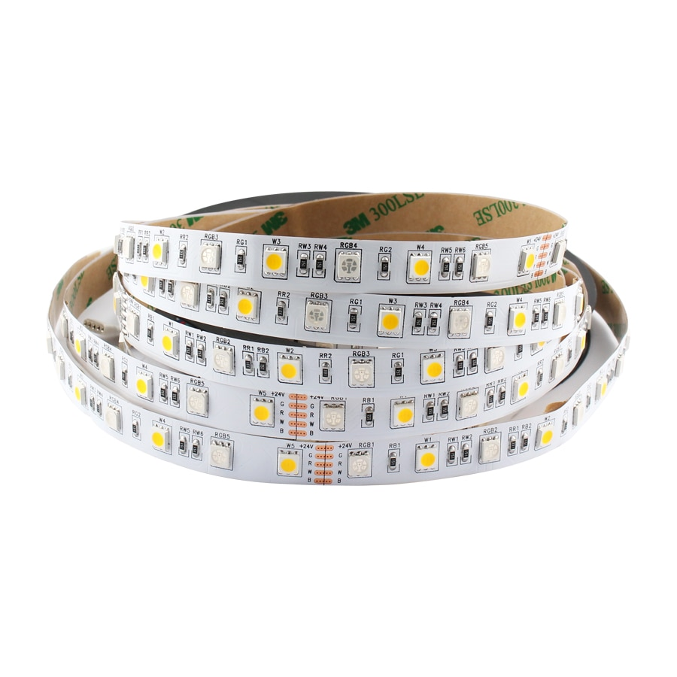
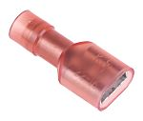
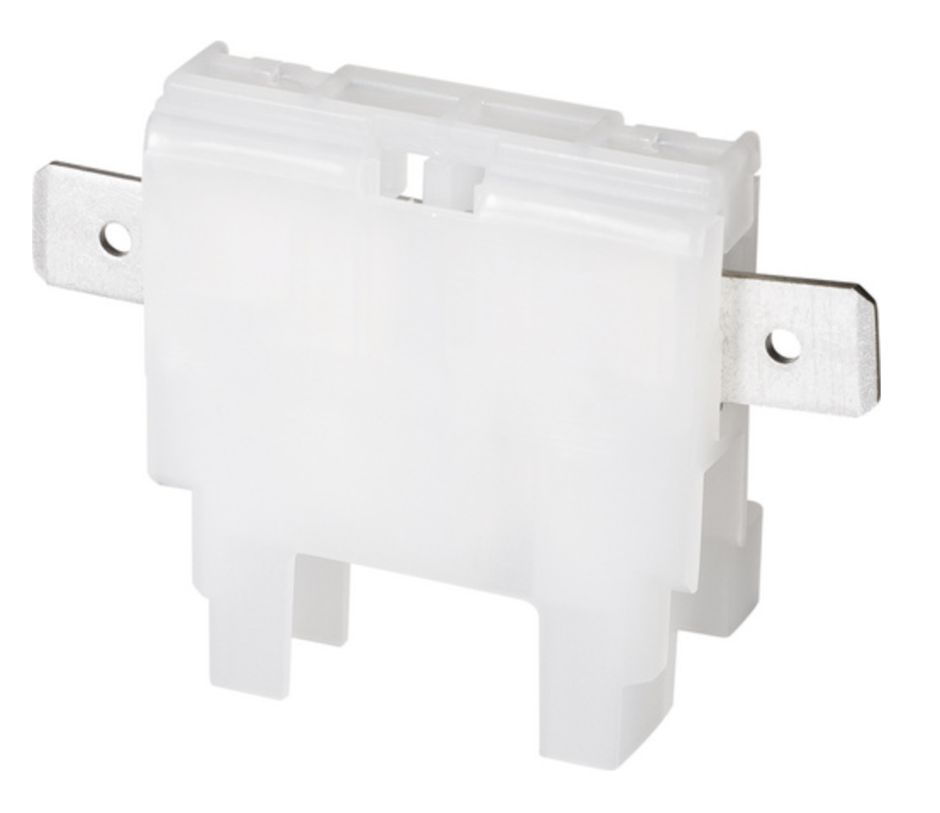
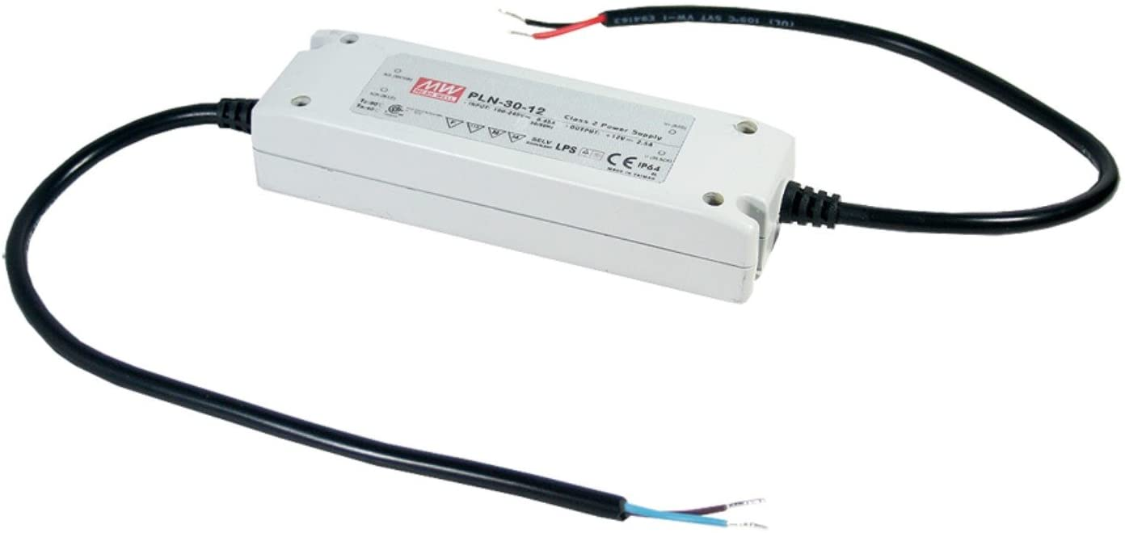
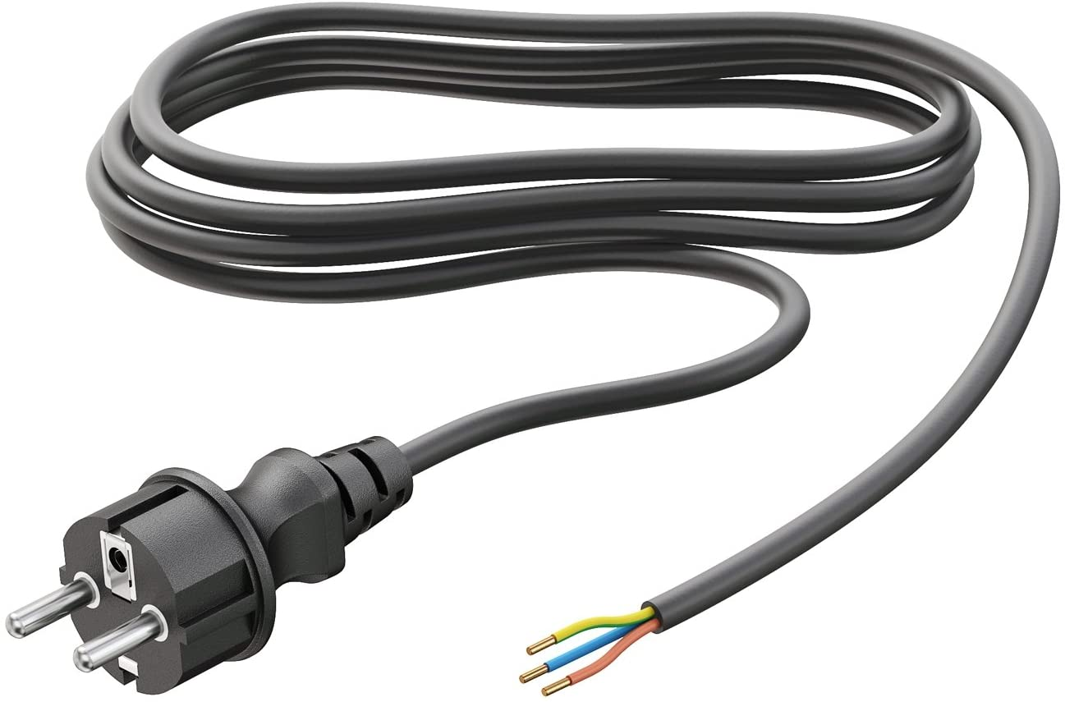

0,75m^2 wire
for 12V
LED Strip
12V LED strip
Wago
4A fuse
Use isolated
crimp connectors
as in cars for 12V,
not for 230V!
1 2 3
!
30W
ask eletrician for 230V wiring!

Slide 16
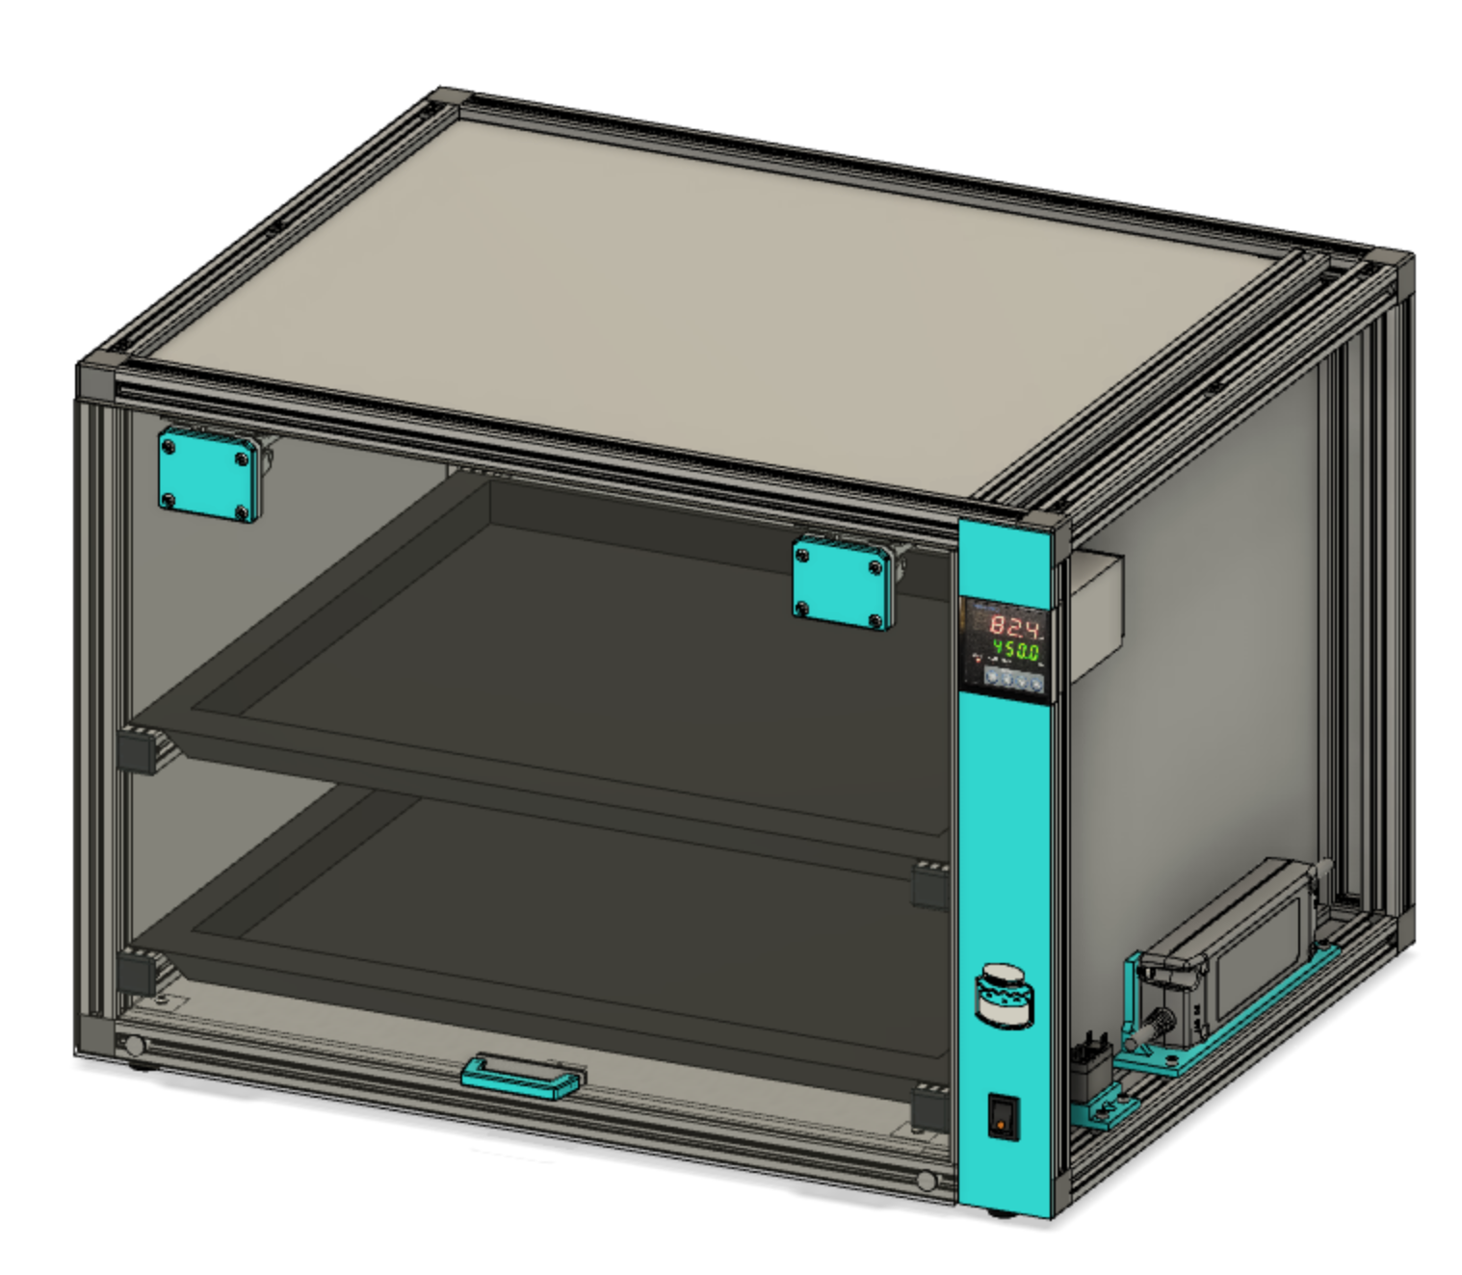
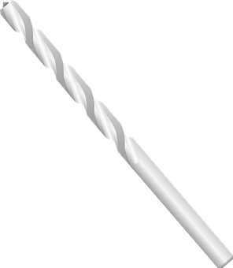
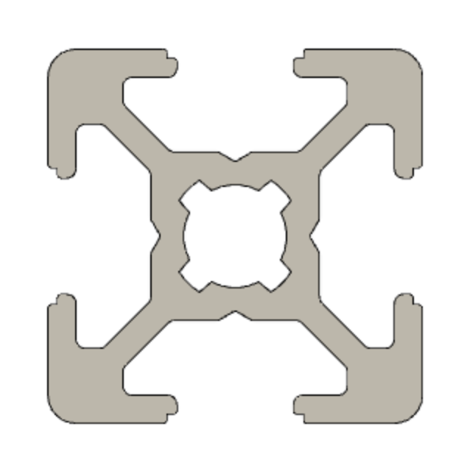
cable to heating pads
4 or 5mm
optional
12V led strips
6mm for sensor

Slide 17
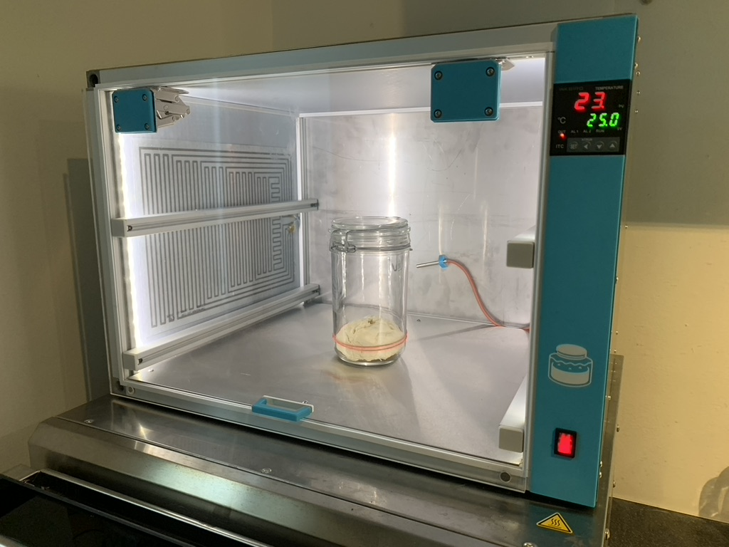

Slide 18
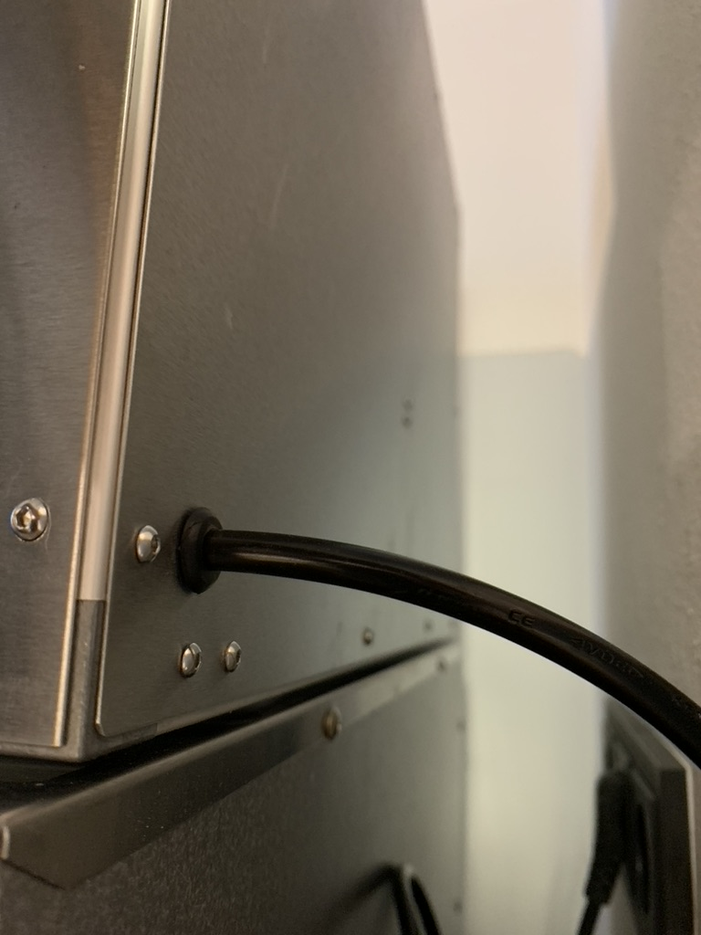

Slide 19
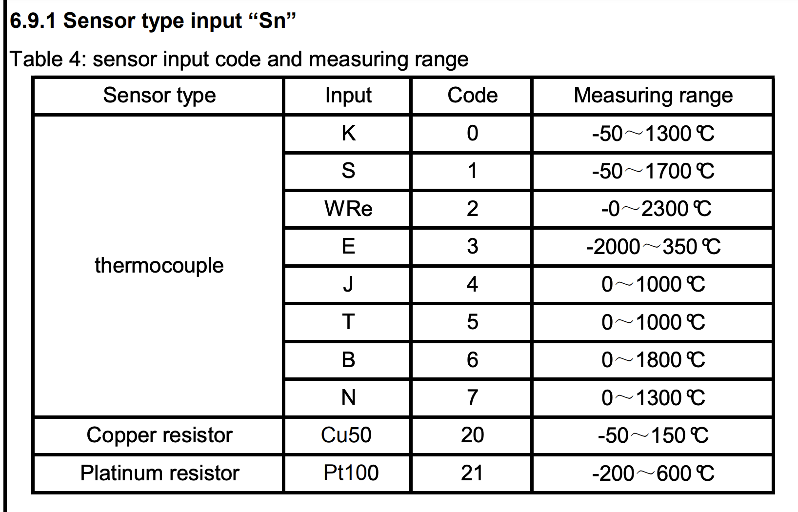
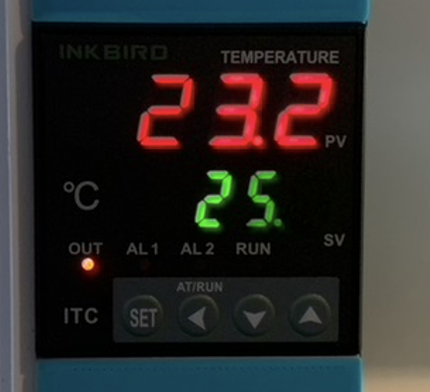
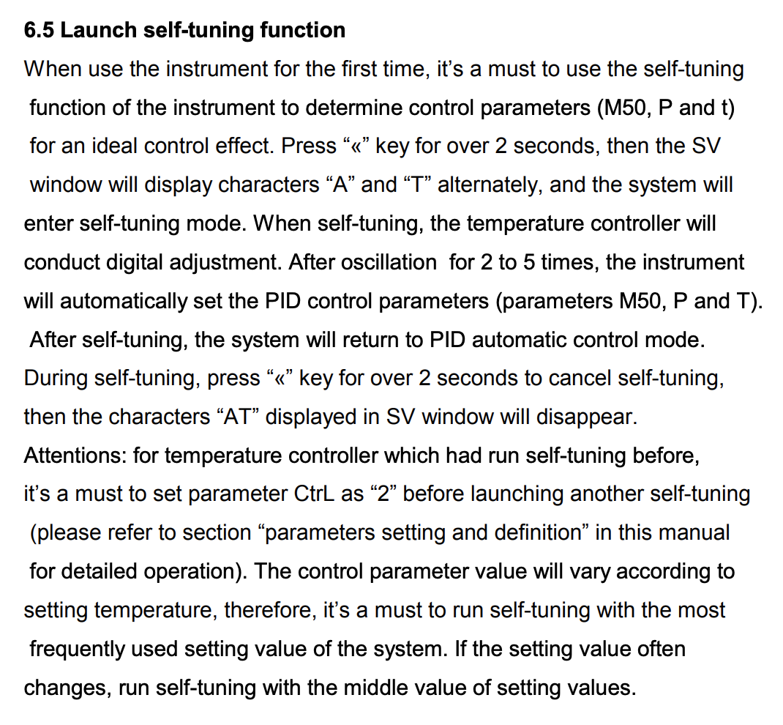
ITV-100 VL

Slide 20
Polypropylen
6mm honeycomp

Slide 21
Stainless steel
0.8mm

Slide 22
Stainless steel
0.8mm

Slide 23
Bosch 6 nut 20x20
aluminium profile
Warning: two of
the profiles are
CNC milled to have
space for the
ITC-100.

Slide 24
Acrylic glas
(Plexi glas)
5mm
Optional milled
1mm deep holes
for the magnet.
Can alos be glued
onto the surface.

